Slide 1
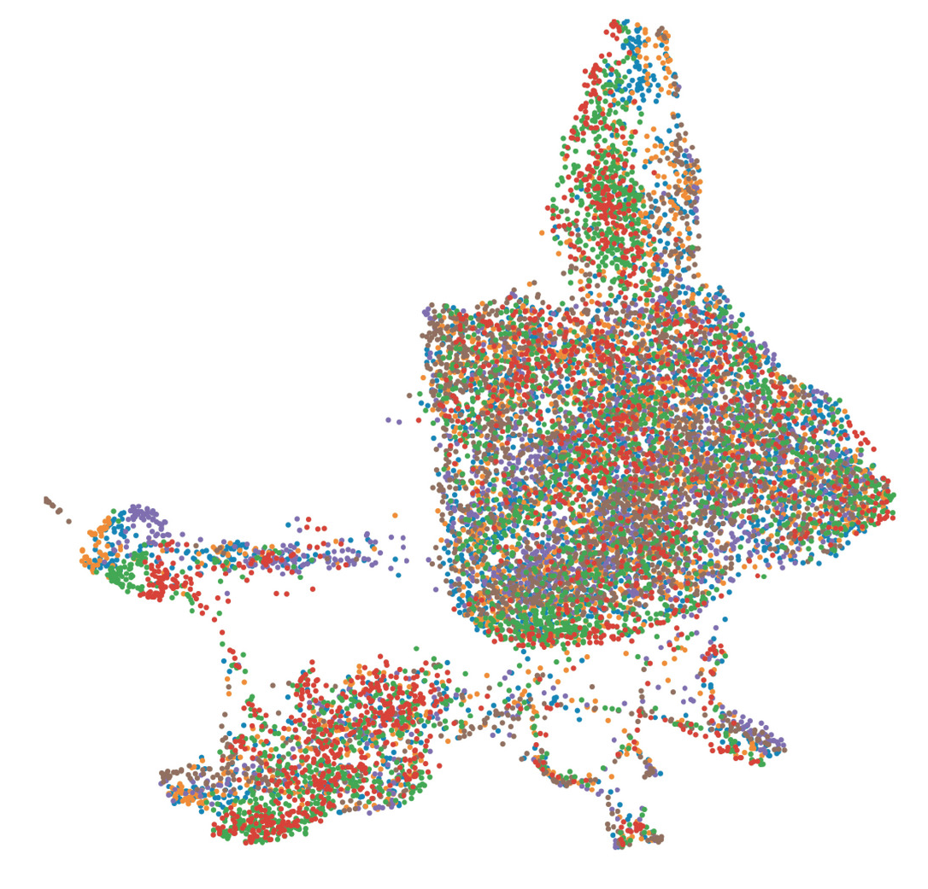
Quantitative Methods in Genetic and Genomics Single Cell Module
Rob Morey
February 7th, 2023

Slide 2
Module Overview
Day 1:
Single cell RNA-seq methods/biochemistry (lecture)
Break
Analysis methods and options (lecture)
Day 2:
Data analysis using Liu et al., "Reprogramming roadmap reveals route to human induced trophoblast stem cells"; Nature 2020
Additional practice data analysis using 10x Genomics PBMC dataset (https://support.10xgenomics.com/single-cell-gene-expression/datasets/1.1.0/pbmc3k)

Slide 3
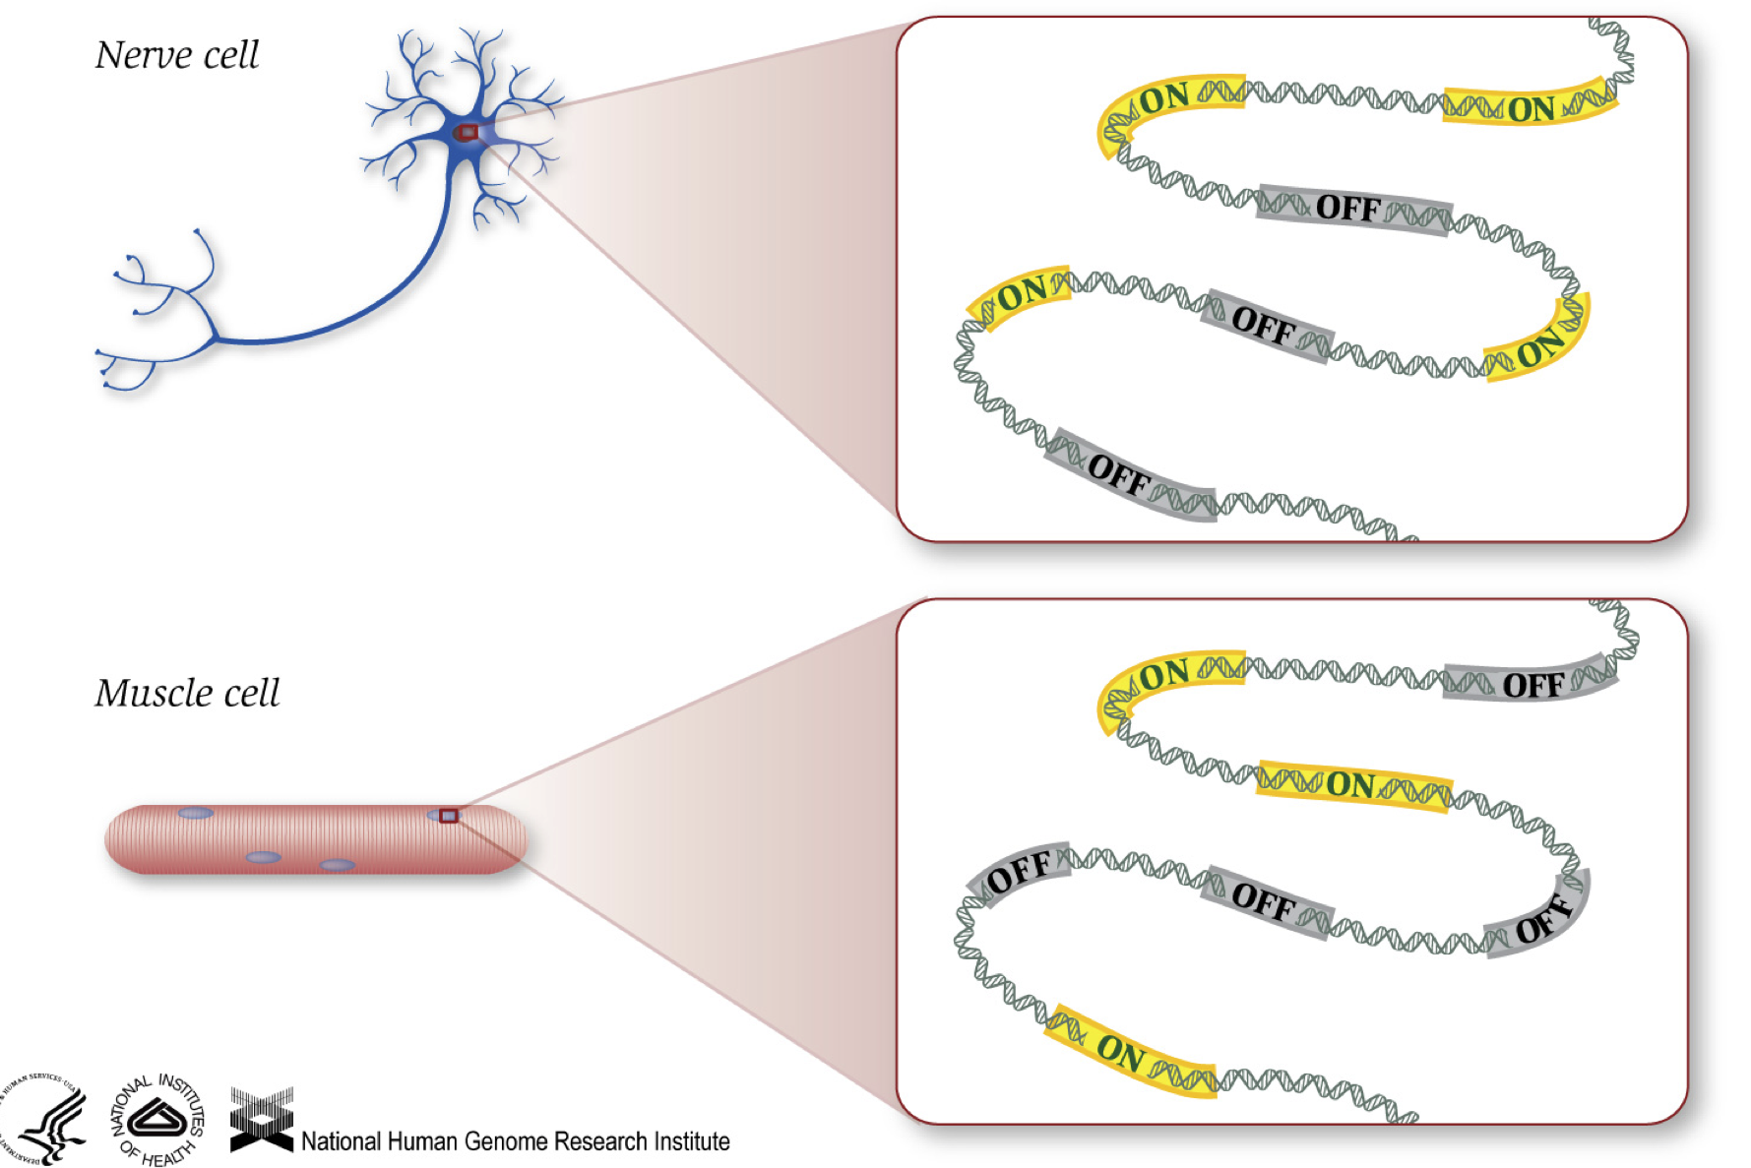
Introduction to RNA-seq
Cell specialization is due to cells turning different genes on and off to produce different proteins. RNA-seq, sequences the RNA in cells to provide a window into what genes are being transcribed at a given time
Notes:
Any given tissue of cell type expresses 11,000 to 13,000 genes, of which 3000 to 5000 have a cell-type specific expression pattern and the rest of the genes are ubiquitously expressed.

Slide 4
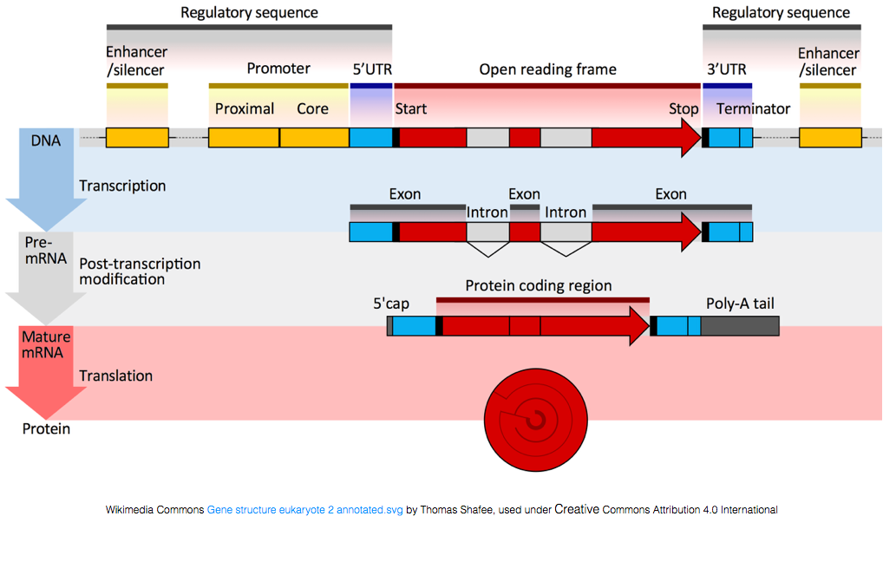
Introduction to RNA-seq – transcript basics
mRNA transcripts have a poly-A tail, most non-coding RNA transcripts do not
Notes:
Any given tissue of cell type expresses 11,000 to 13,000 genes, of which 3000 to 5000 have a cell-type specific expression pattern and the rest of the genes are ubiquitously expressed.

Slide 5
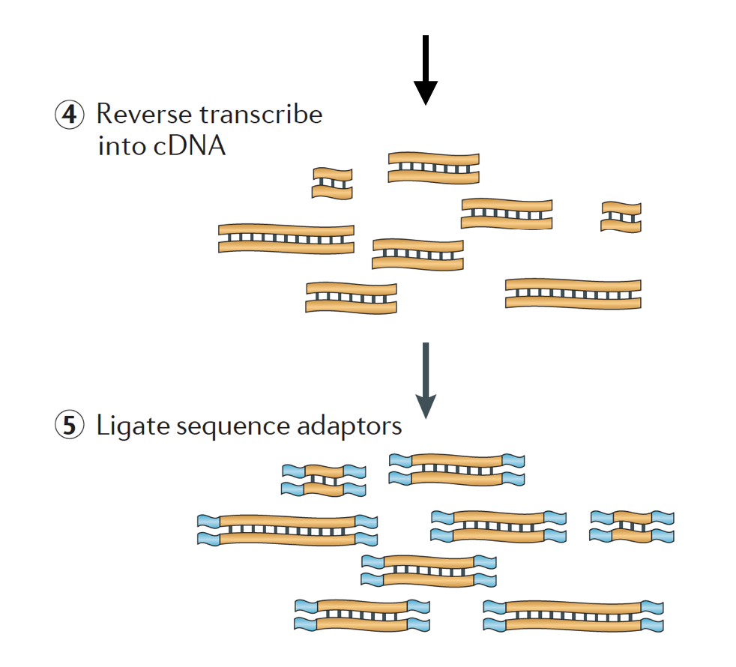
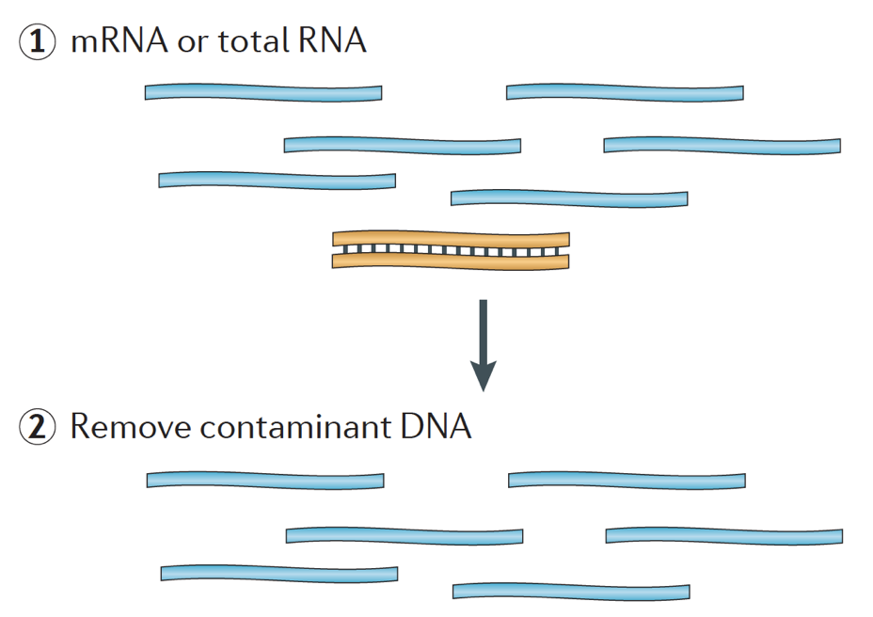
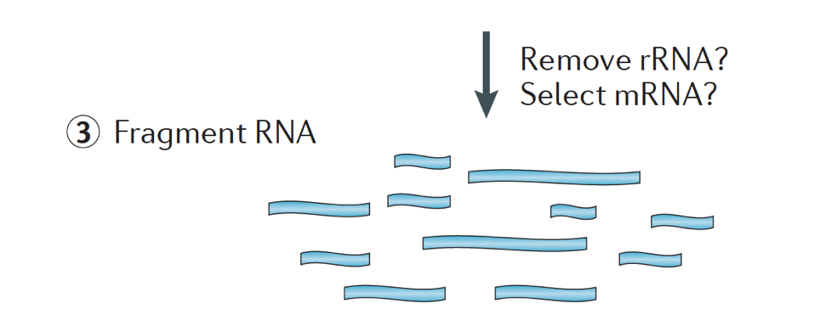
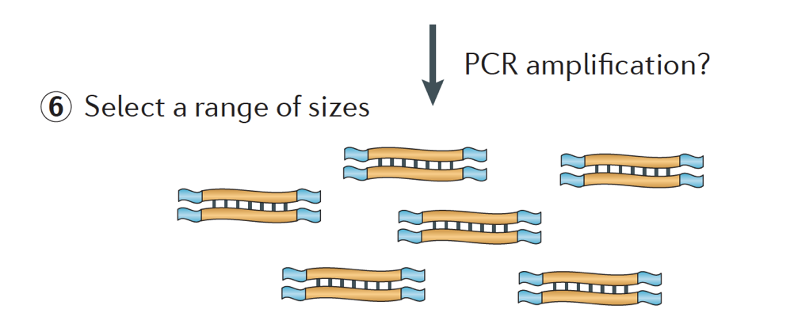
Introduction to RNA-seq – library prep
Image credit: Martin J.A. and Wang Z., Nat. Rev. Genet. (2011) 12:671–682
mRNA or total RNA is isolated, rRNA is removed, RNA is fragmented, reverse transcribed to make cDNA, adapters are added for PCR and sequencing
Notes:
Any given tissue of cell type expresses 11,000 to 13,000 genes, of which 3000 to 5000 have a cell-type specific expression pattern and the rest of the genes are ubiquitously expressed.

Slide 6
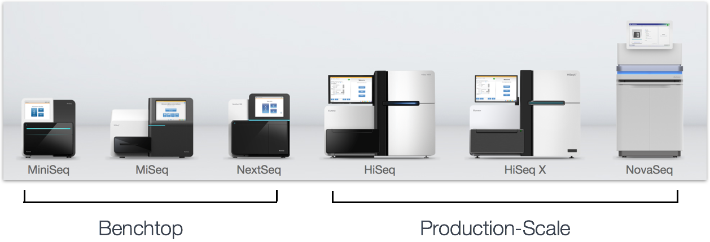
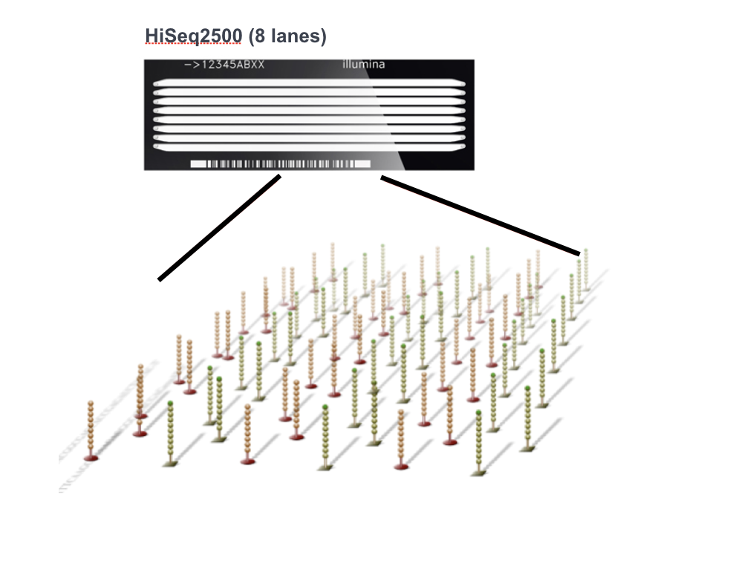
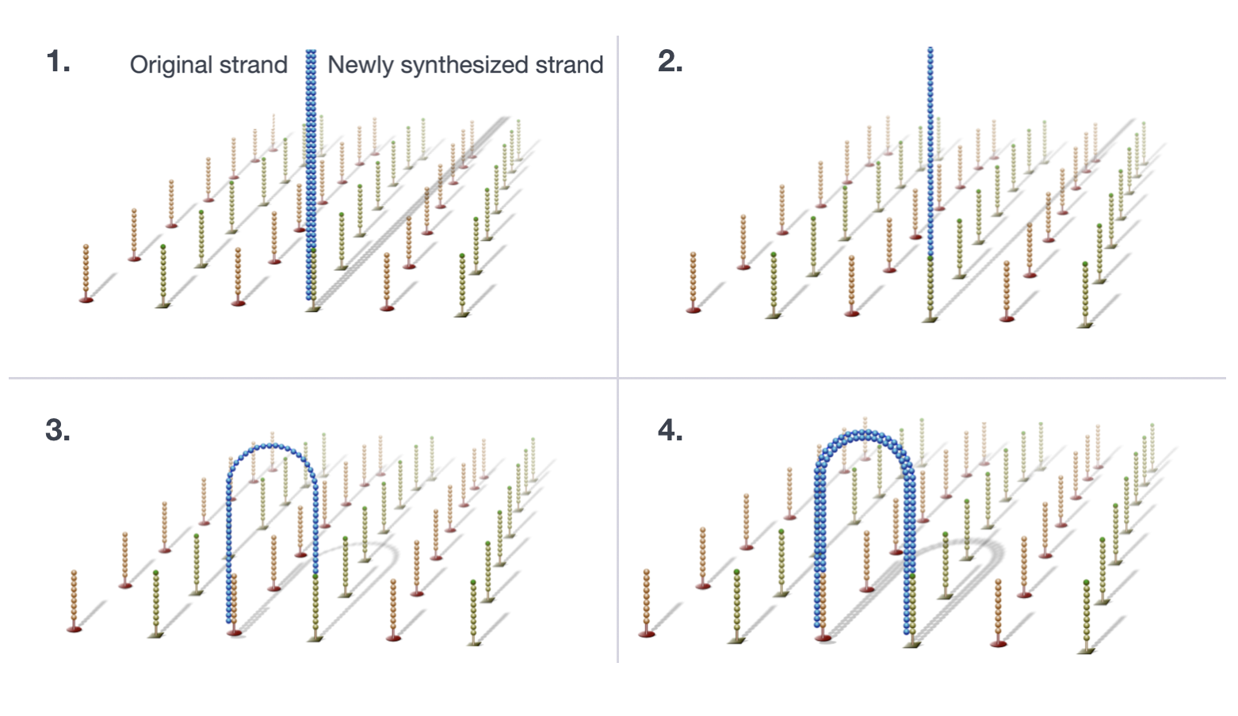
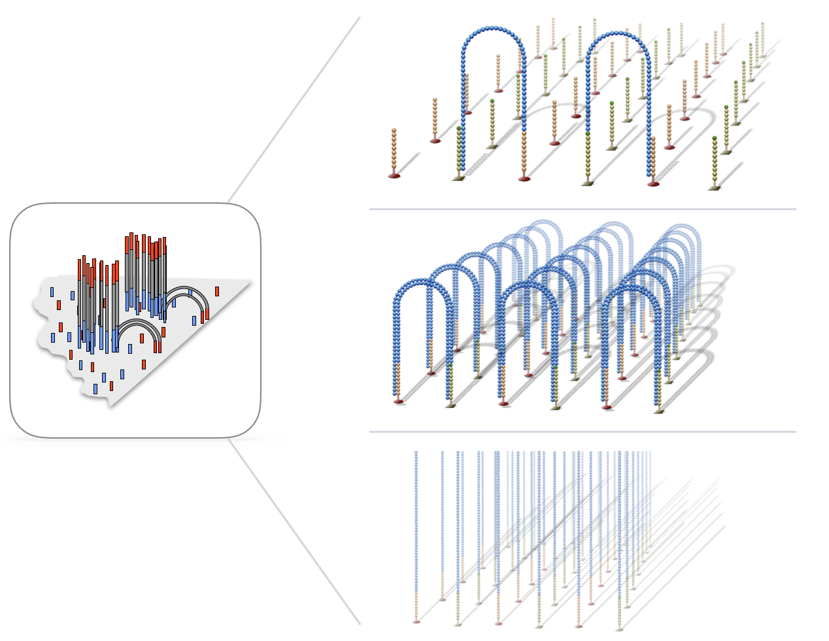
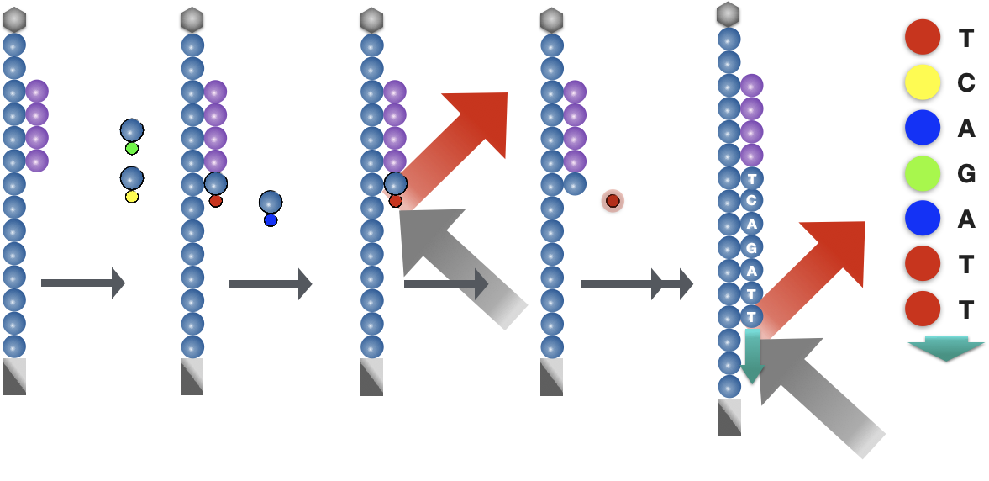
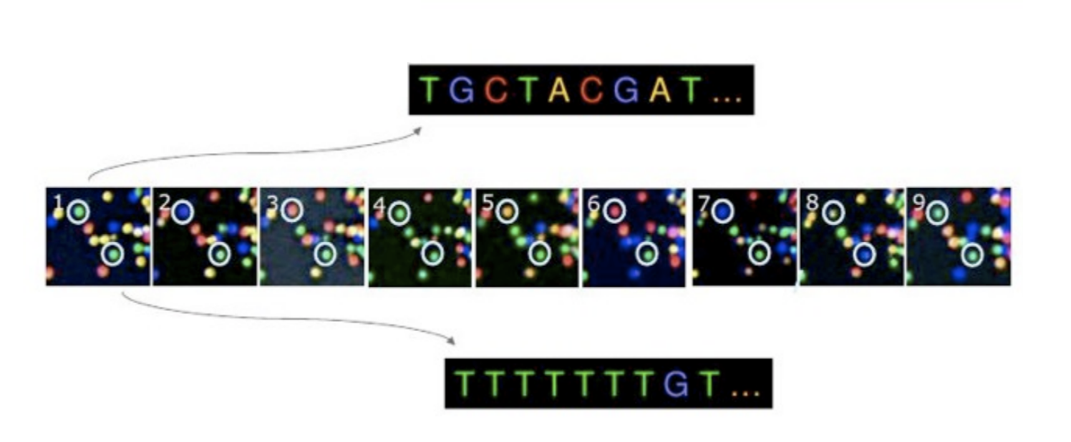

Introduction to RNA-seq – sequencing by synthesis
Illumina sequencing platforms
Illumina flowcell
Illumina cluster generation
Illumina image acquisition
Illumina basecalling
Number of clusters ~= Number of reads
Number of sequencing cycles = Length of reads
SE or PE reads
Image credit: Adapted from Illumina

Slide 7
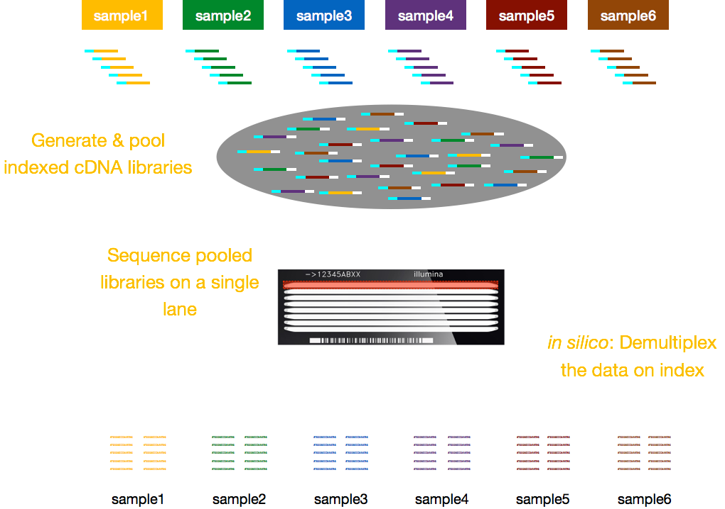
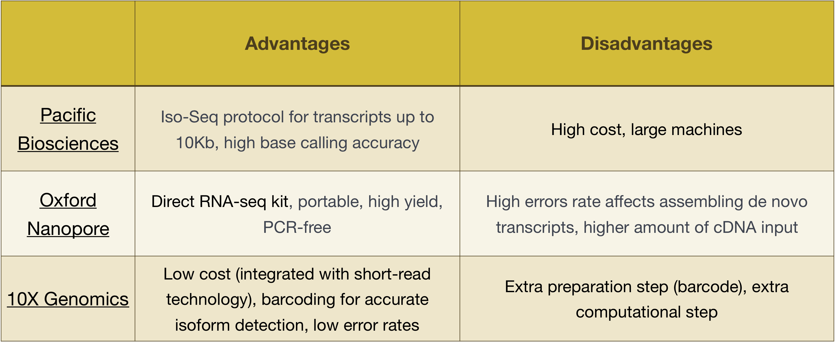
Introduction to RNA-seq - multiplexing
Image credit: Adapted from Harvard Chan Bioinformatics Chore (HBC)

Slide 8
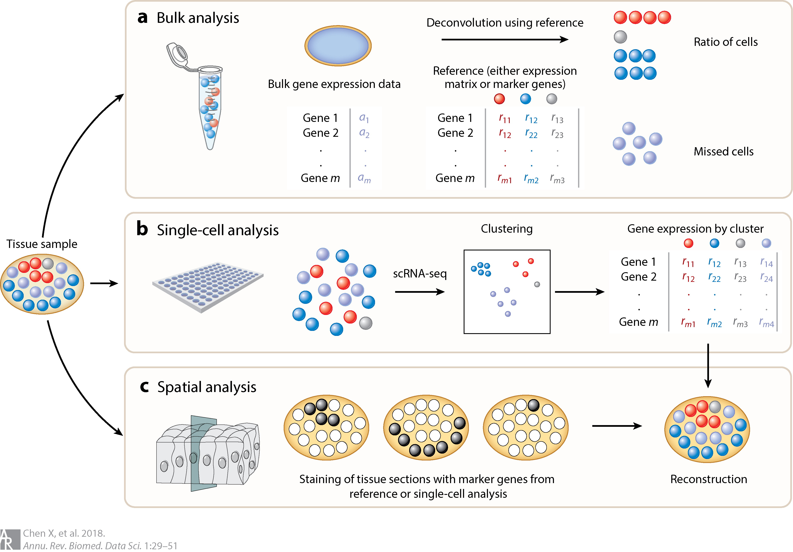
Why single cell transcriptomics?
Microarrays and bulk RNA sequencing mask the true distribution of gene expression levels across cells.
Notes:
Any given tissue of cell type expresses 11,000 to 13,000 genes, of which 3000 to 5000 have a cell-type specific expression pattern and the rest of the genes are ubiquitously expressed.

Slide 9
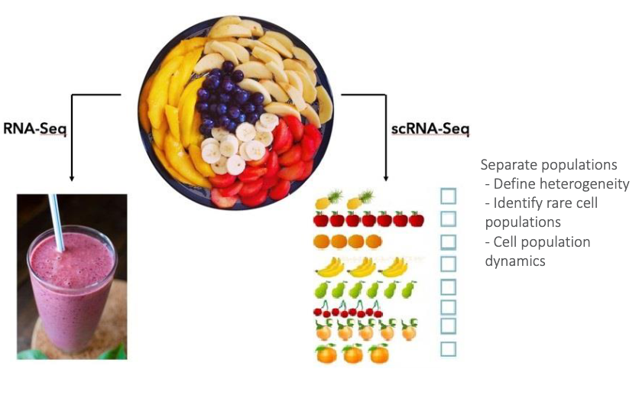
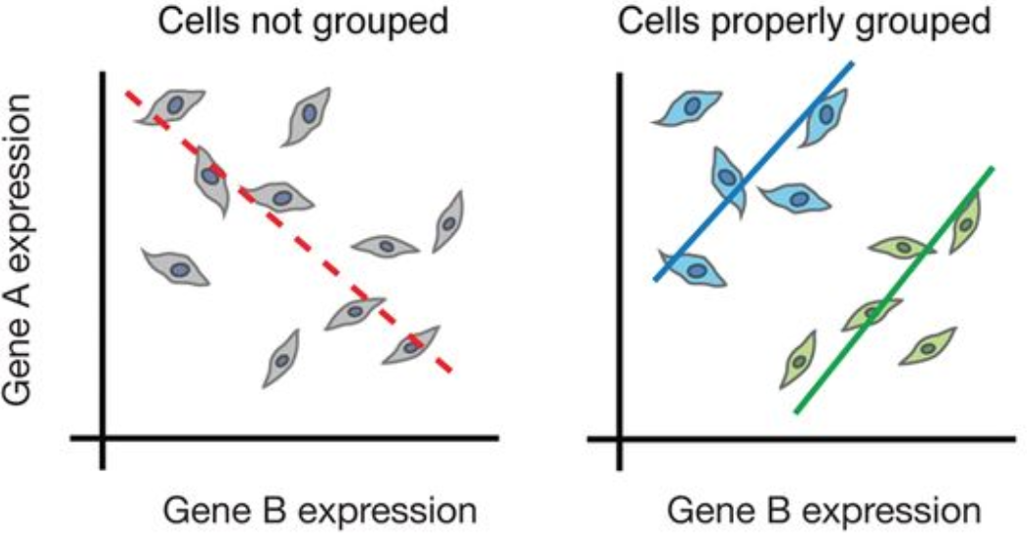
Bulk vs single cell RNA-seq
Why use scRNA-seq?
Discover which cell types are present in a sample
Identify unknown/rare cell types or states hidden in bulk RNA-seq
Monitor changes in gene expression during differentiation or across time/states
Identify genes that are differentially between cell types/states
Can be paired with spatial information or protein information (CITE-seq)
Image credit: (Left) Cambridge), (Right) Trapnell, C. Defining cell types and states with single-cell genomics, Genome Research 2015 (doi: https://dx.doi.org/10.1101/gr.190595.115)

Slide 10
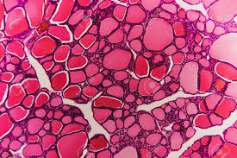
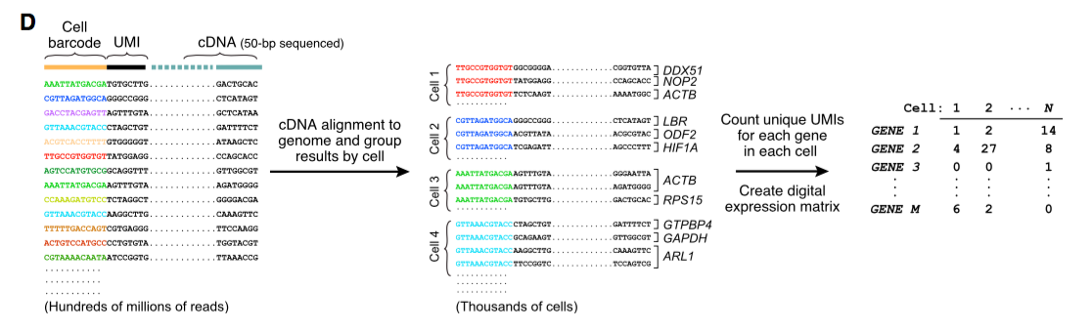
How do we go from cell to count matrix?

Slide 11
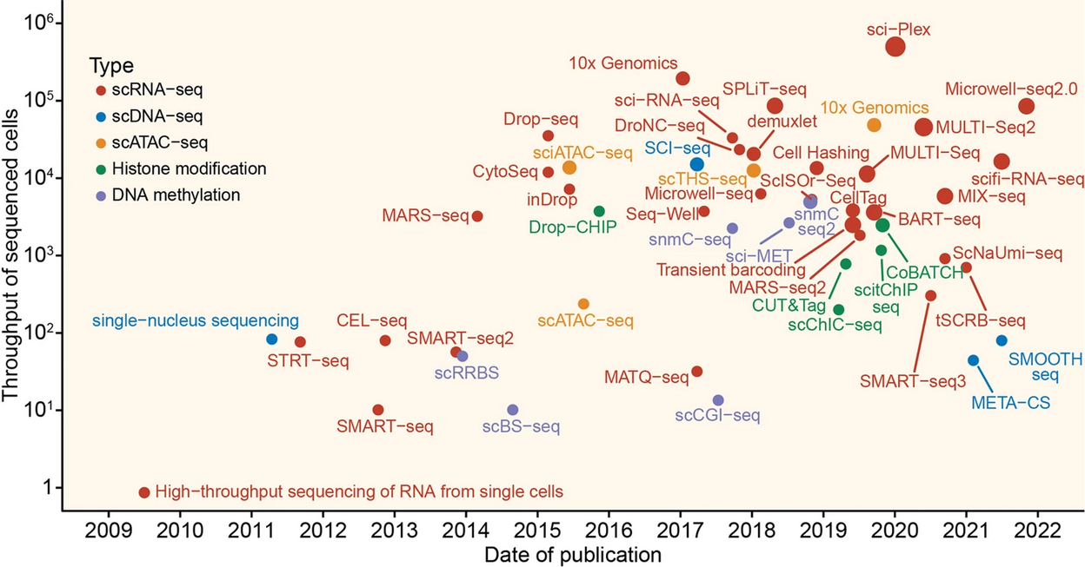
A decade of single-cell RNA-seq
Signal Transduction and Targeted Therapy volume 7, Article number: 145 (2022)

Slide 12
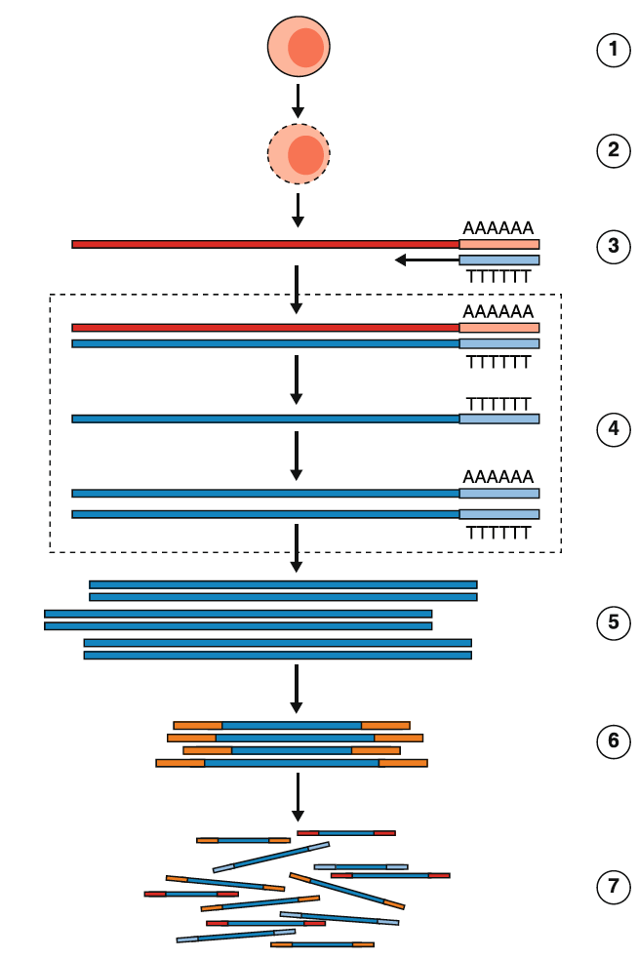
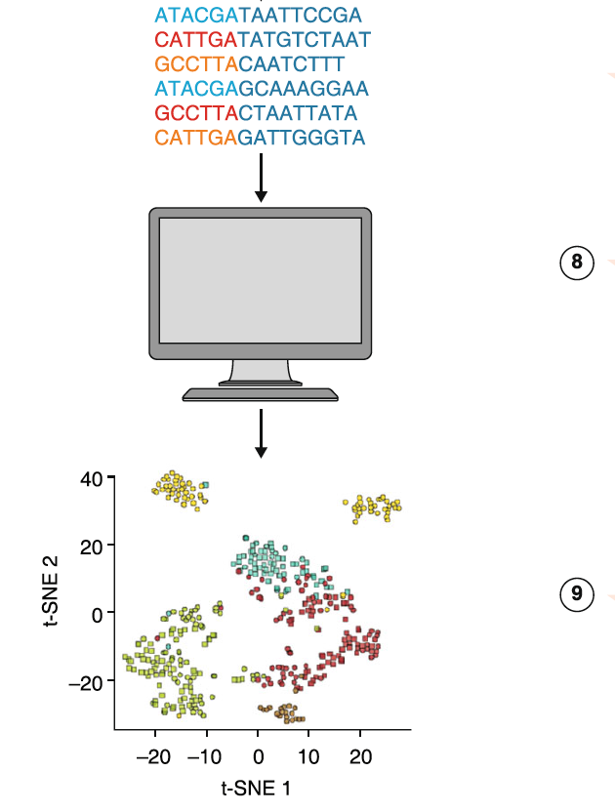
General workflow of a single cell (sc) RNA-Seq experiment
Critical Steps
Cell Isolation (cell or nuclei)
Cell lysis
mRNA capture
Cell Barcoding
Demultiplexing/counting
Second Strand Generation
cDNA amplification
Analysis
Library Construction
Pool and sequence
Haque et al., 2017 Genome Medicine

Slide 13
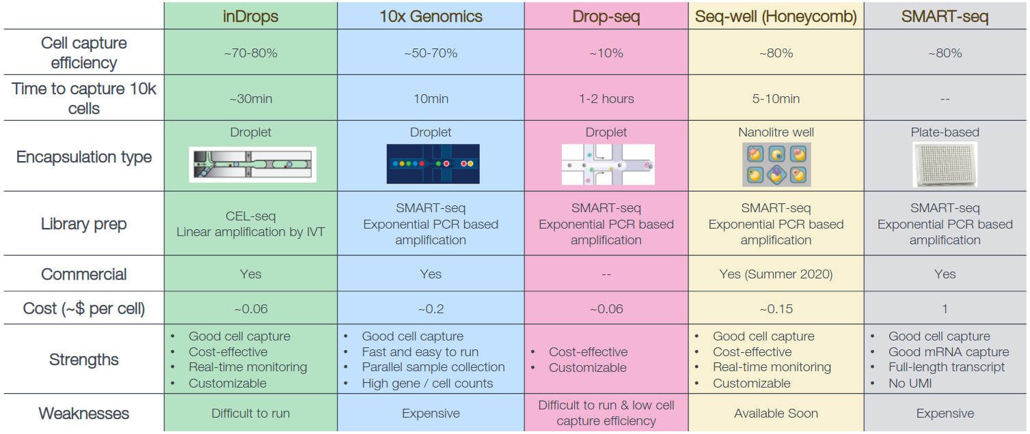
Popular single-cell RNA-seq protocols
HBCtraining via C. Ziegenhain et al., Comparative Analysis of Single-Cell RNA Sequencing Methods, Molecular Cell 2017 (doi: 10.1016/j.molcel.2017.01.023)

Slide 14
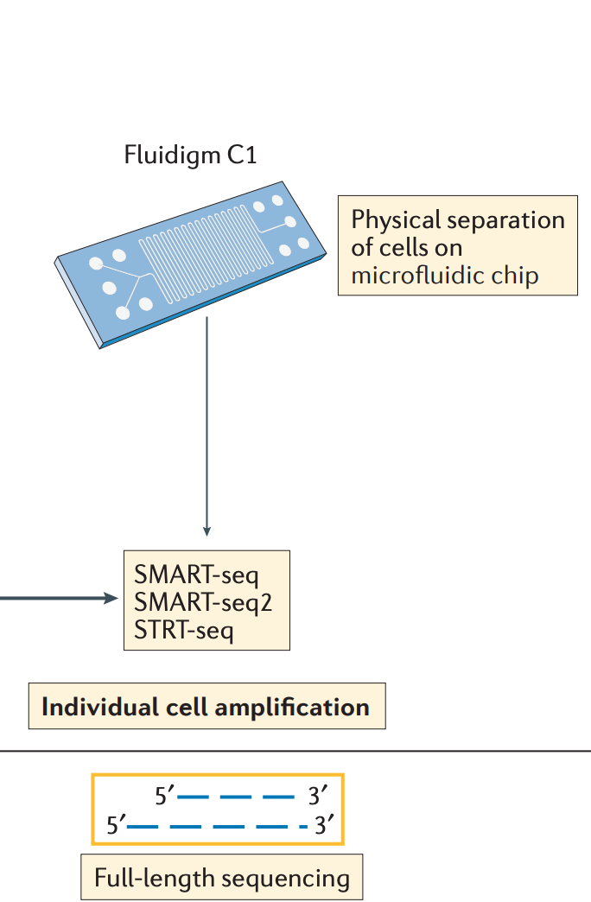
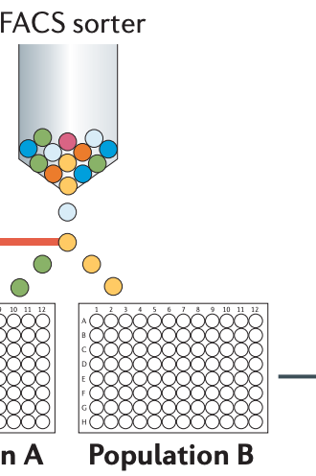
Full length transcripts: SMRT-seq
Allows for either sorting of cells into individual wells or separating cells based on size on a microfluidic chip (Fluidigm)
Gives full transcript information
Ideal for low cell numbers (100's – 1,000's)
Papalexi and Satija, 2017. DOI:10.1038/nri.2017.76

Slide 15
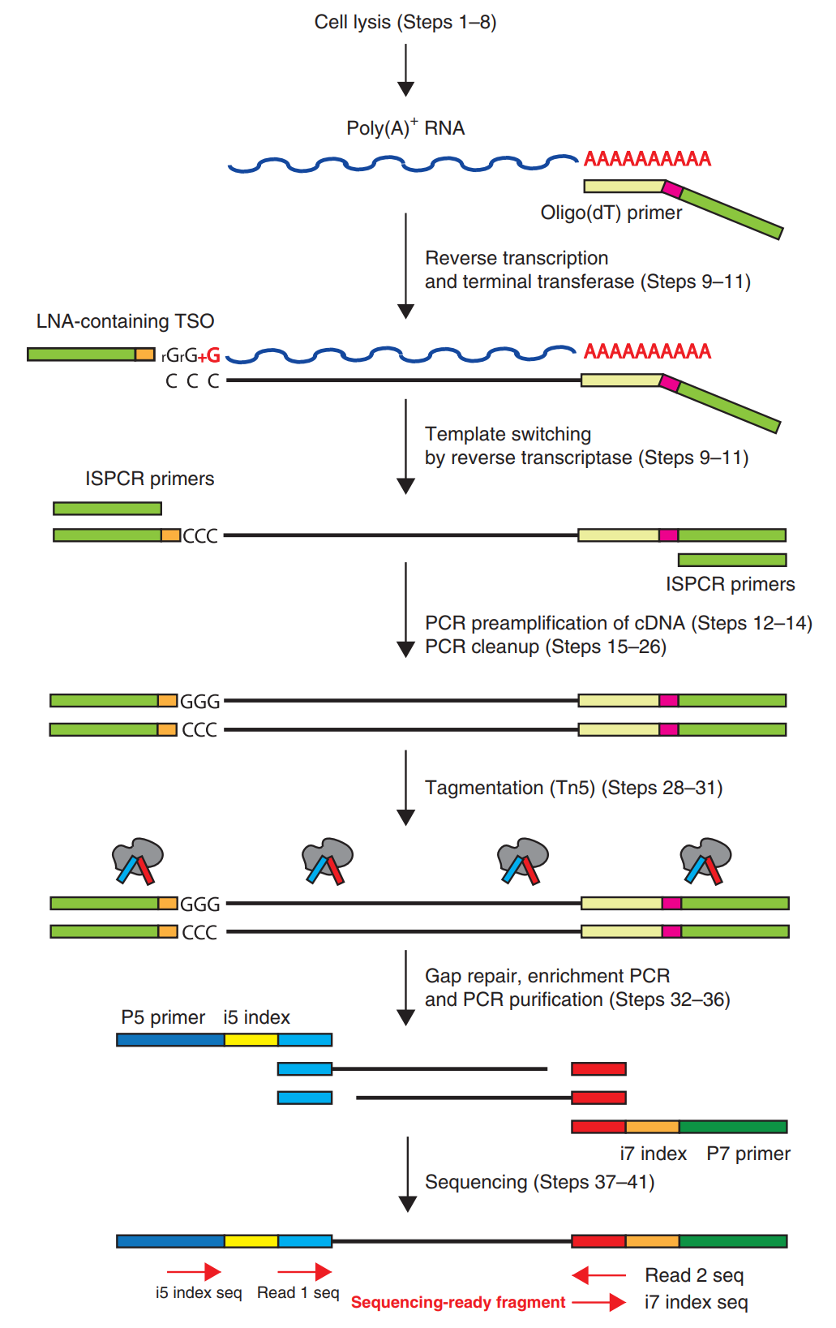
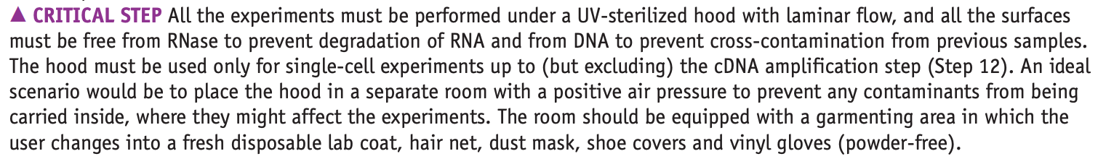
Example: library preparation for SMART-Seq2
Picelli et al., 2014. DOI:10.1038/nri.2017.76

Slide 16
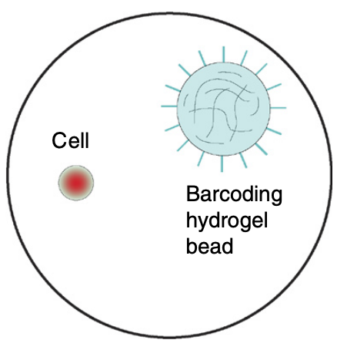
Droplet vs. Physical Microfluidic methods: Beads, Cells, and Droplets
• Droplet methods give single cell information, BUT require high cell numbers to achieve best results. (>10,000 cells) • Capture 50-80% of the input cells depending on the platform used. • Extreme 3’-bias in standard data. • Can not look at splicing / isoforms with standard methods.
Zilionis et al. 2016. DOI:10.1038/nprot.2016.154

Slide 17
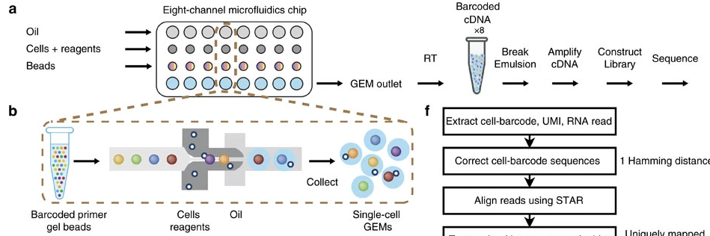
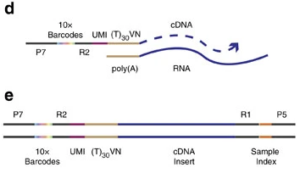
10X Genomics Overview
Zheng et al., 2017 Nature Communications​

Slide 18

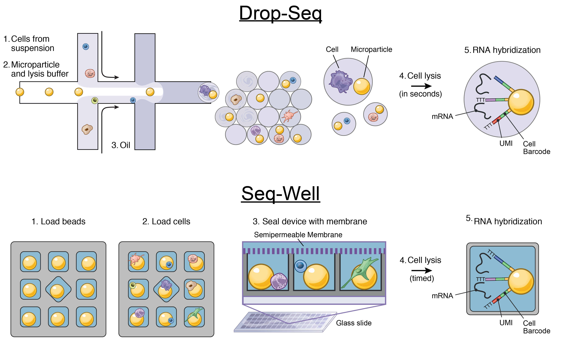
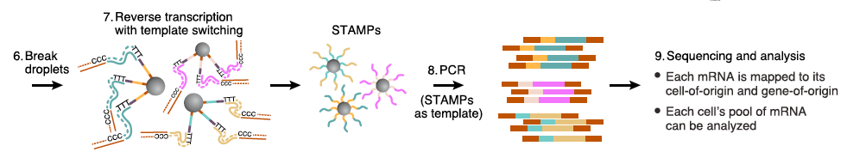
Drop-Seq
Macosko et al., 2015 Cell

Slide 19
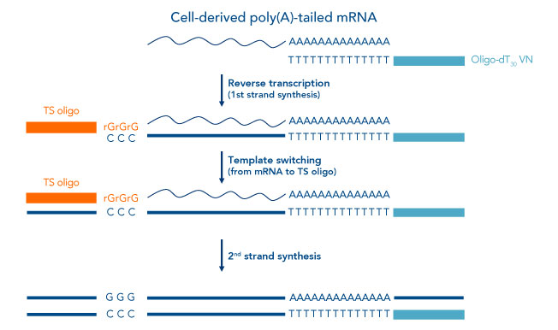
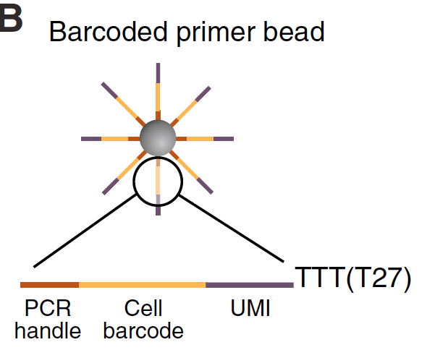
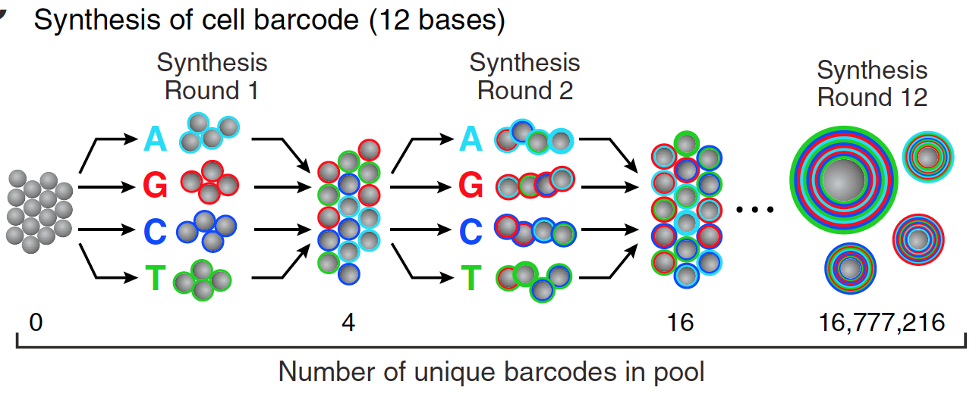
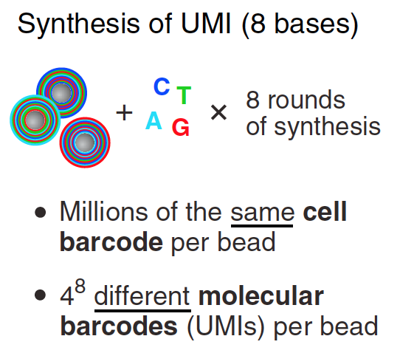
3’ end Capture Beads - UMIs and Bead Barcodes
UMI
BBC
PCR
4¹² = 16,777,216 barcodes
4⁸ = 65,536 UMIs
> 10⁶ oligos/bead
Macosko et al., 2015 Cell

Slide 20
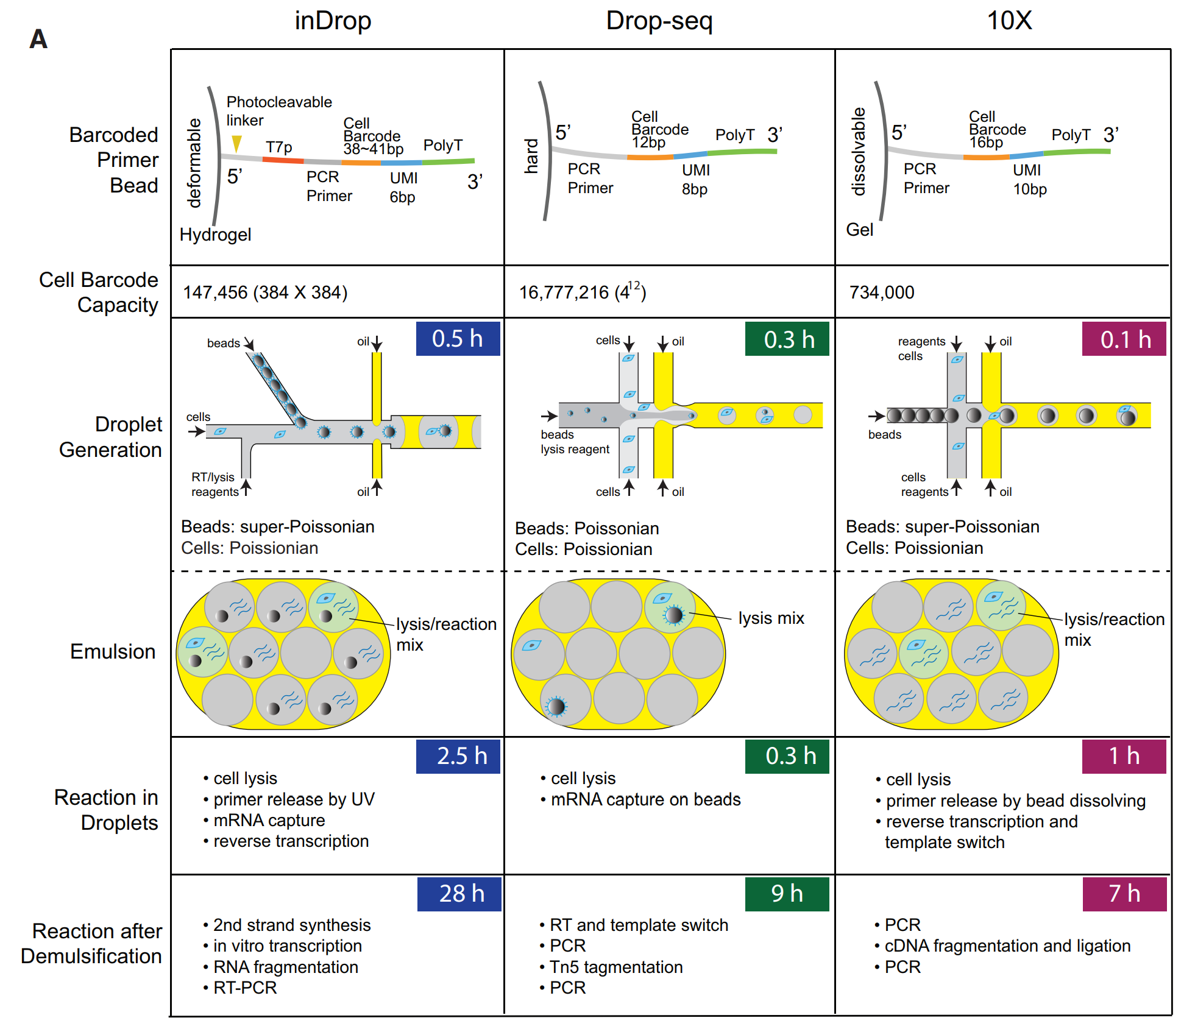
Summary of droplet technologies
Zhang et al. 2019. DOI:10.1016/j.molcel.2018.10.020

Slide 21
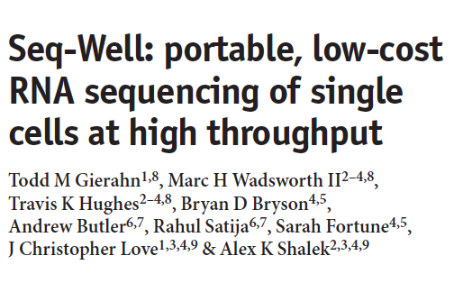

Seq-Well abrogates the need for droplet-based microfluidic devices

Slide 22
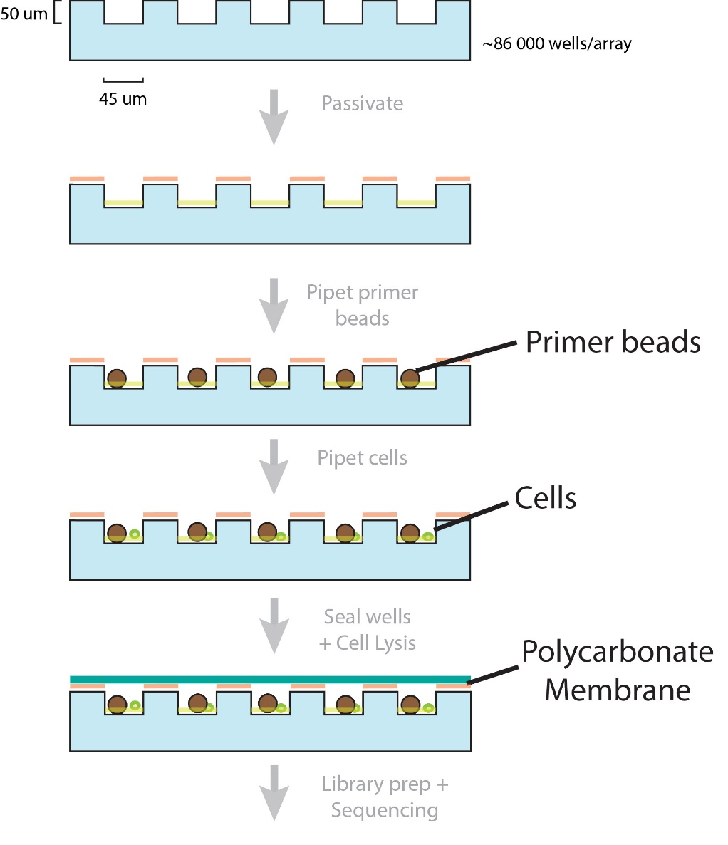
Seq-Well workflow in Images
Pre-wash
100 um
Post-wash + shake
100 um

Slide 23
Seq-Well workflow in Images
Pre-cell loading
100 um
Cell
Post-cell loading + shake
Bead
Capture rate > 50%
100 um

Slide 24
Common problems - Technical doublets
Technical doublets arise when two or more cells are captured in a droplet with a single bead. The technical doublet rate is therefore the probability of capturing two or more cells in a droplet given that at least one cell has been captured in a droplet:
Note that “overloading” a microfluidics single-cell experiment by loading more cells while keeping flow rates constant will increase the number of technical doublets due to an effective increase in and also the number of synthetic doublets due to a decrease in relative barcode diversity.

Slide 25
Doublet detection: the barnyard plot
Croset et al. 2018. DOI:10.7554/eLife.34550

Slide 26
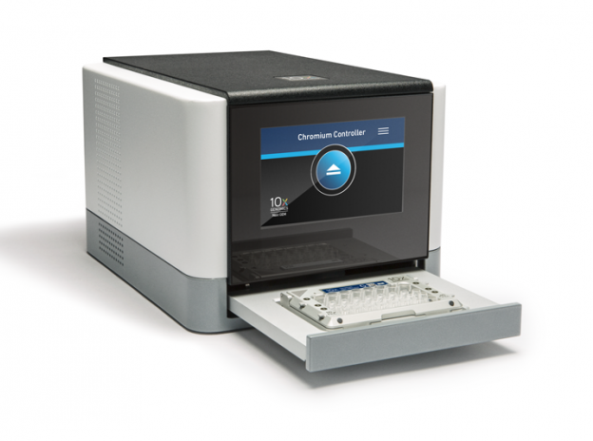
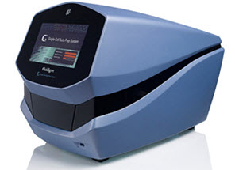
Which is better – full length or 3' end?

Slide 27
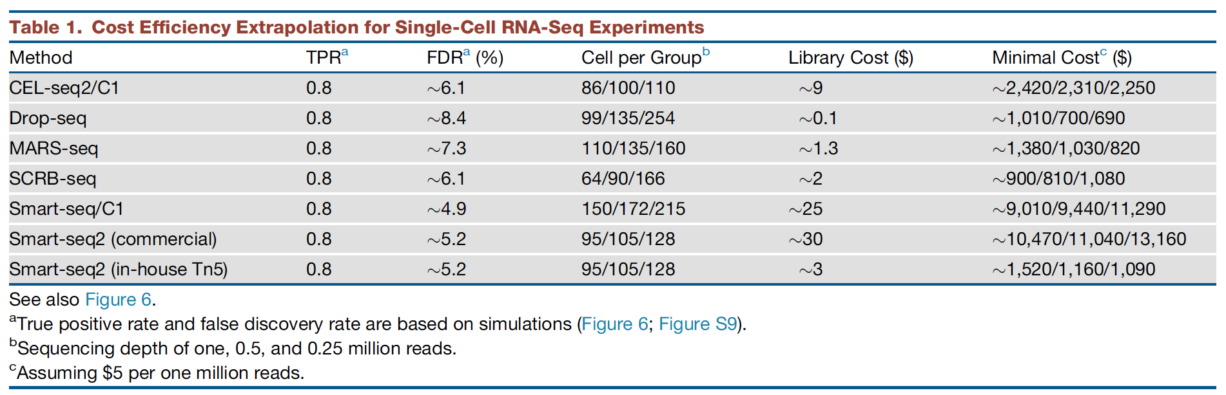
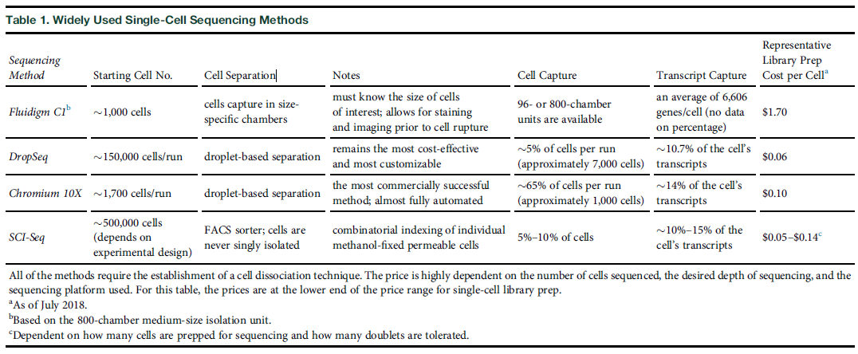
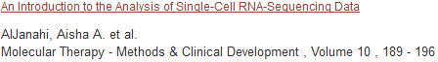
Single cell technologies (3’-end vs full-length)
Ziegenhain et al., 2017 Molecular Cell

Slide 28
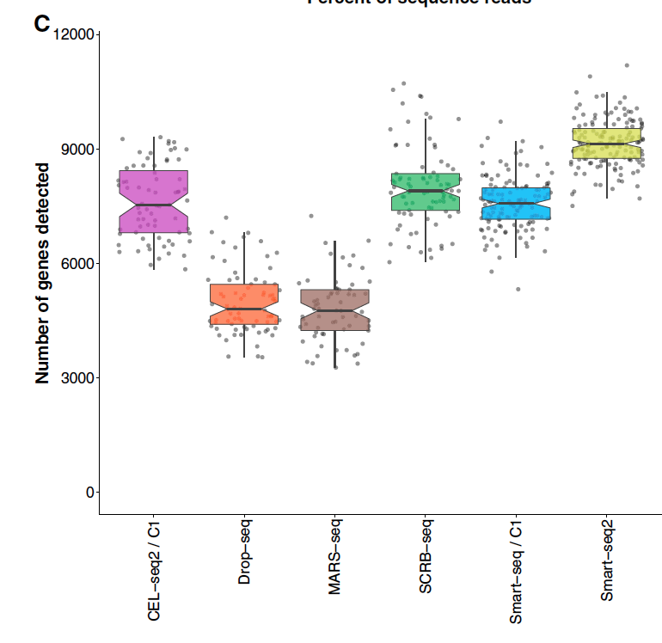
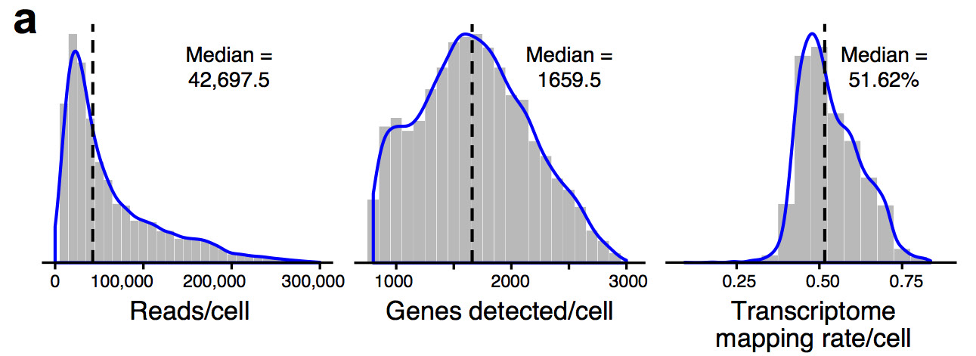
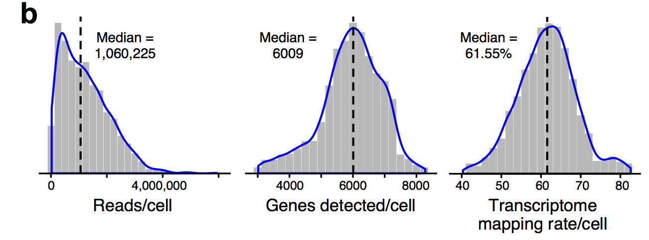
3’-end vs full-length Inter-platform comparison
10X
Smart-Seq2
Ziegenhain et al., 2017 Molecular Cell
Haber et al., 2017 Nature

Slide 29
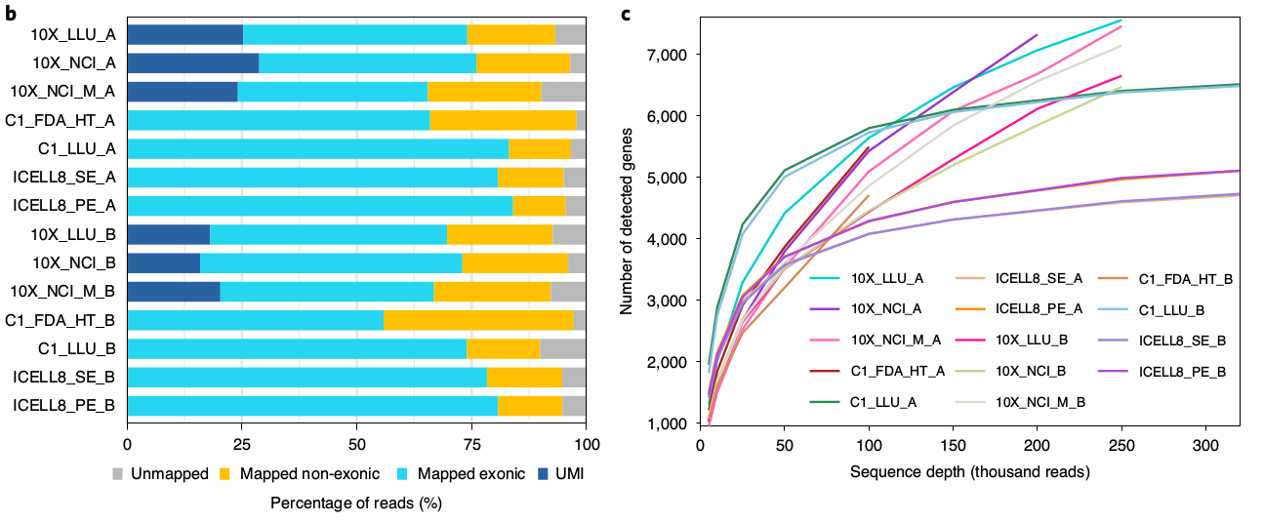
3’-end vs full-length Inter-platform comparison
*
*
*
*
*
*
"*" = Full-length
Chen et al., 2020 Nature Biotech

Slide 30
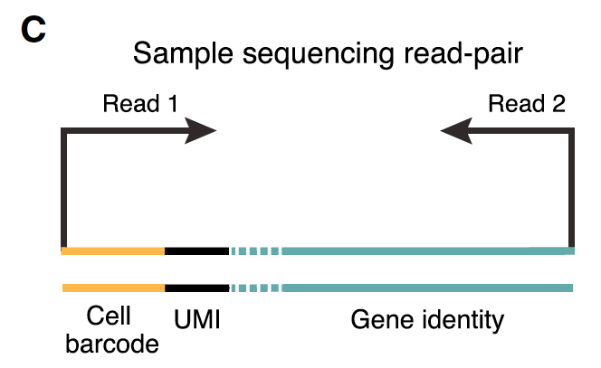
3’-end based technologies Post-sequencing

Slide 31
3’-end based technologies - Post-sequencing
Macosko et al., 2015 Cell

Slide 32

Break Time

